Slide 1
TensorFlow Installation Guide
For Window 10

Slide 2
Contents
Download Anaconda
Install:
Anaconda
TensorFlow
Verify TensorFlow Installation

Slide 3

1. Download Anaconda (Window 64-bit)
Click here: https://www.anaconda.com/distribution/#windows
1
Click:
- Windows icon
- 64 bit …..
2
Hardware Recommendation:
CPU: i5 (64bit) or above
Memory: 4Gb or above
Internet enabled
Window admin right
Downloaded file: Anaconda3-2019.03-Windows-x86_64.exe

Slide 4
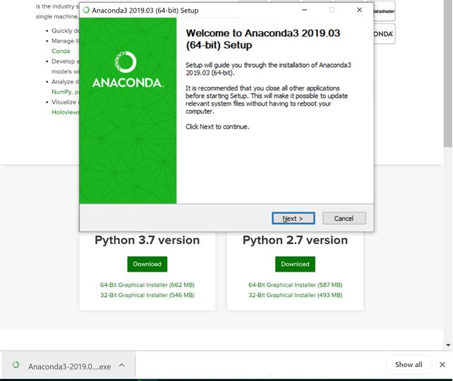
2a. Install Anaconda
Double click: Anaconda3-2019.03-Windows-x86_64.exe
Double click the file
and click “Next >” button.

Slide 5
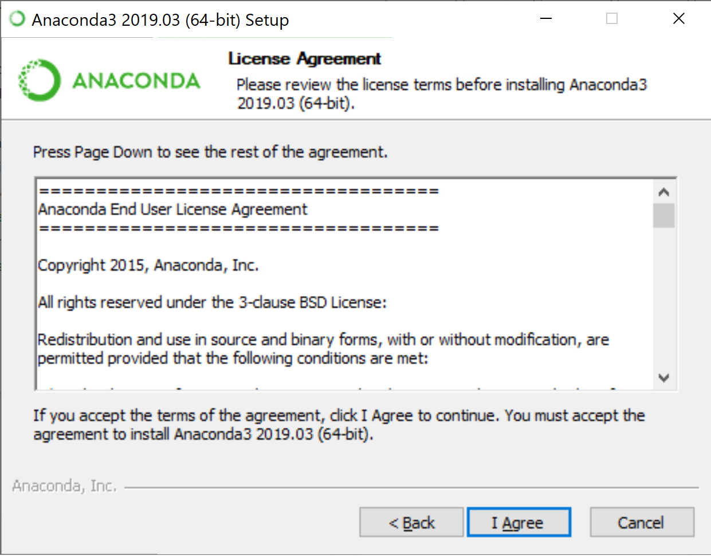
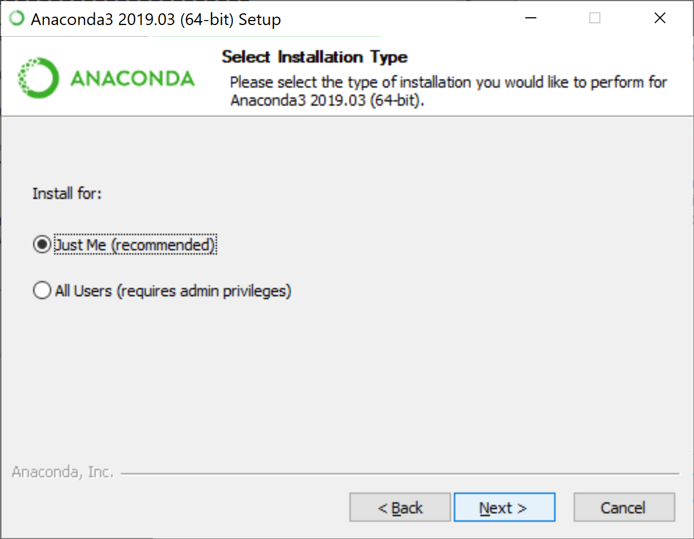
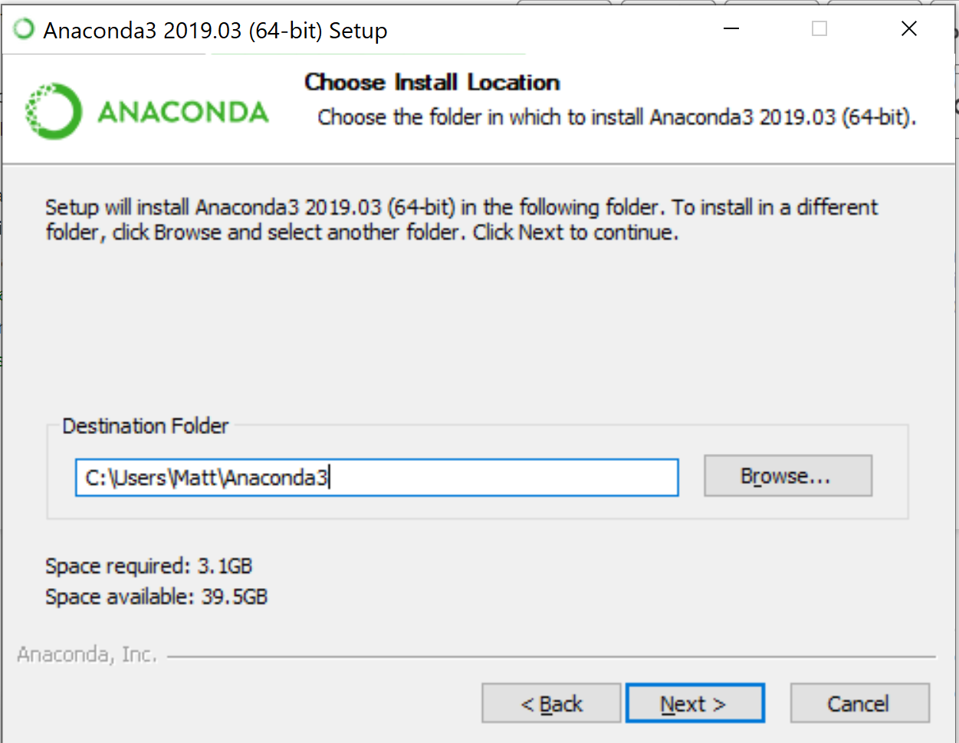
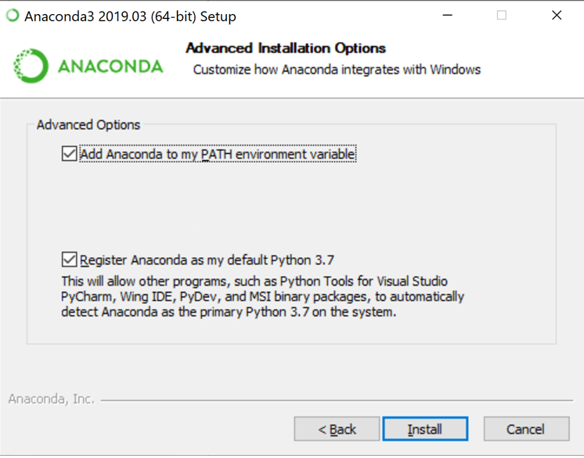
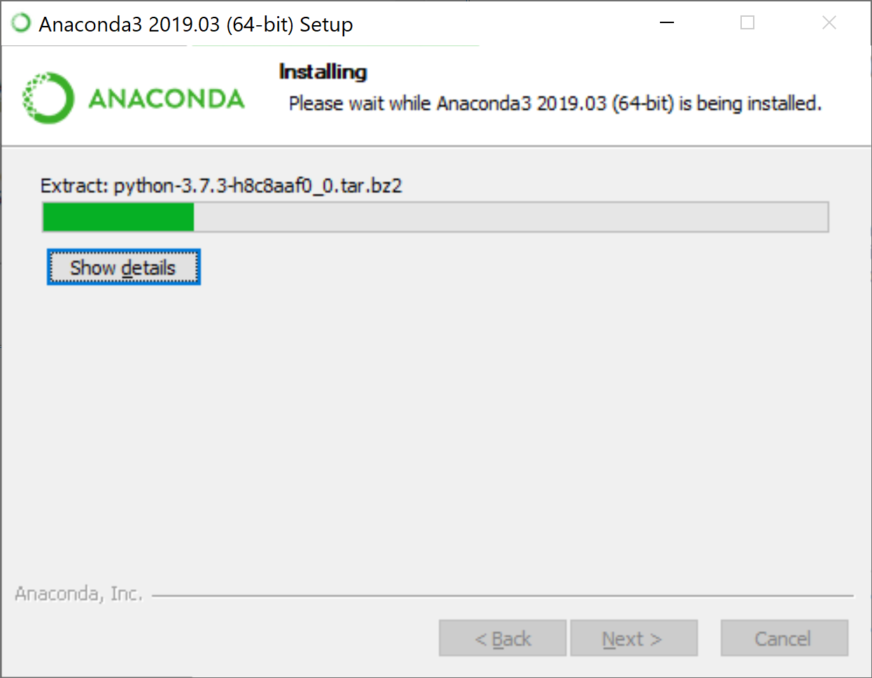
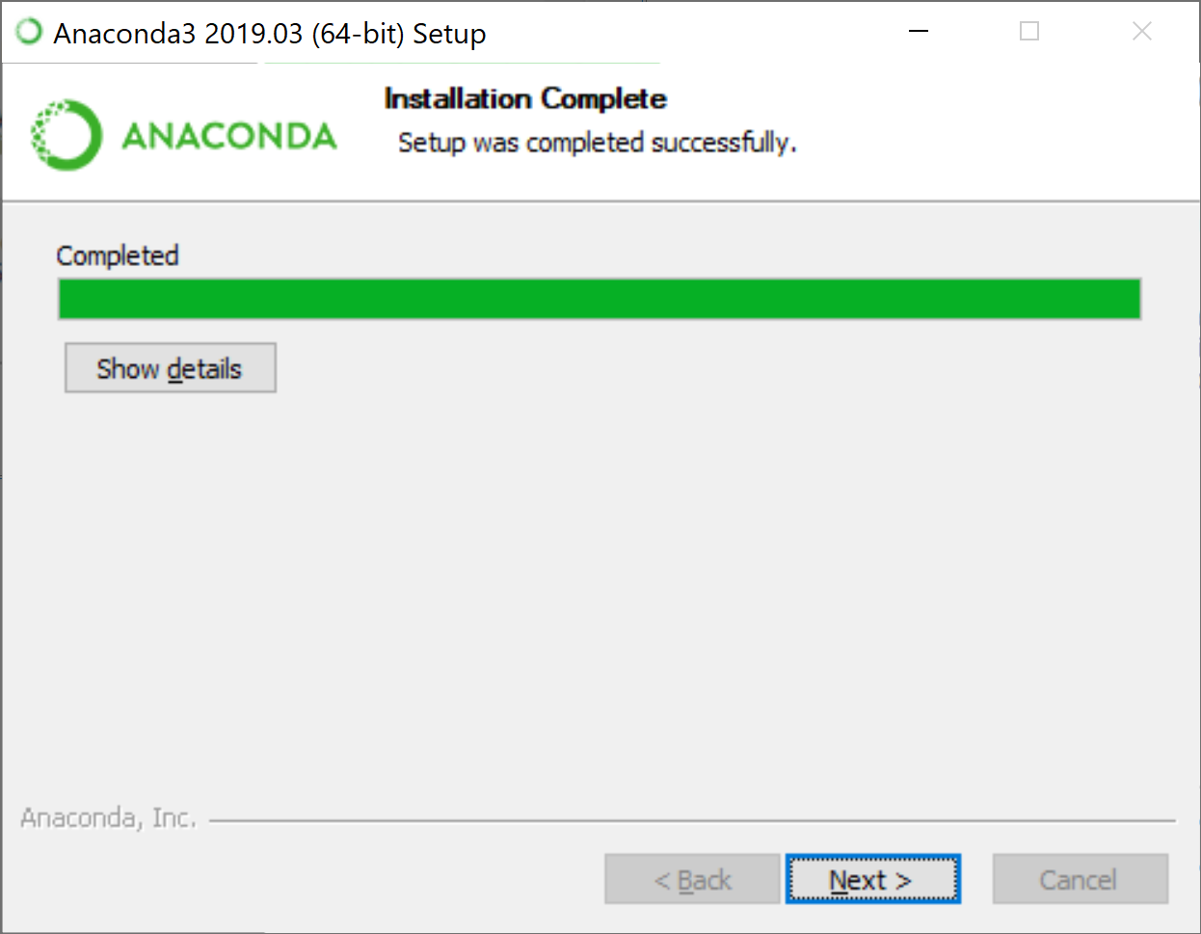
2a. Install Anaconda
Please remember or write down your destination path!
1
2
3
Checked!
4
5
<< Click all the buttons by default! >>

Slide 6
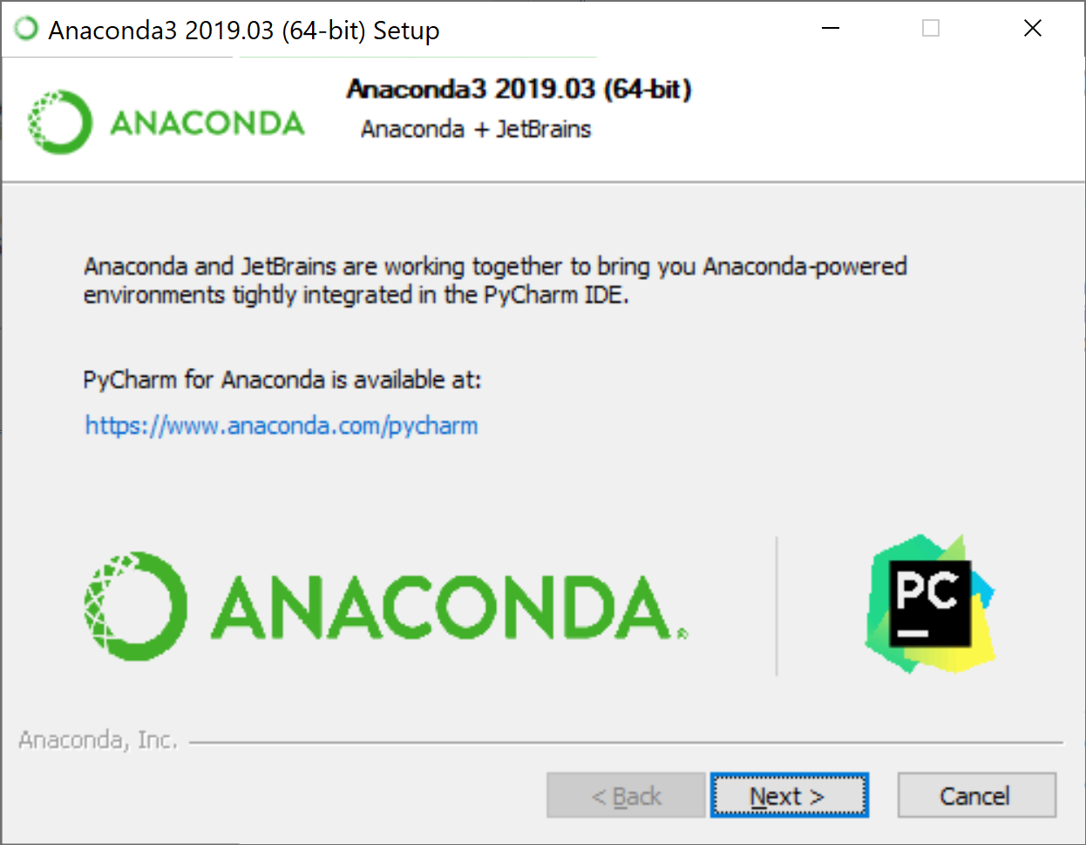

2a. Install Anaconda
6
7
<< Click “Next >” & “Finish” button ( Anaconda installation completed! ) >>

Slide 7
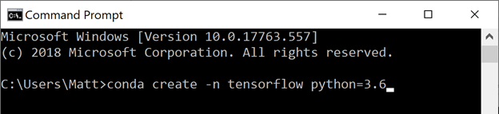
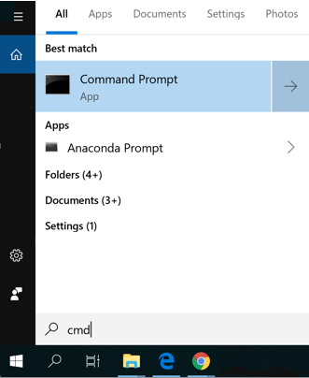
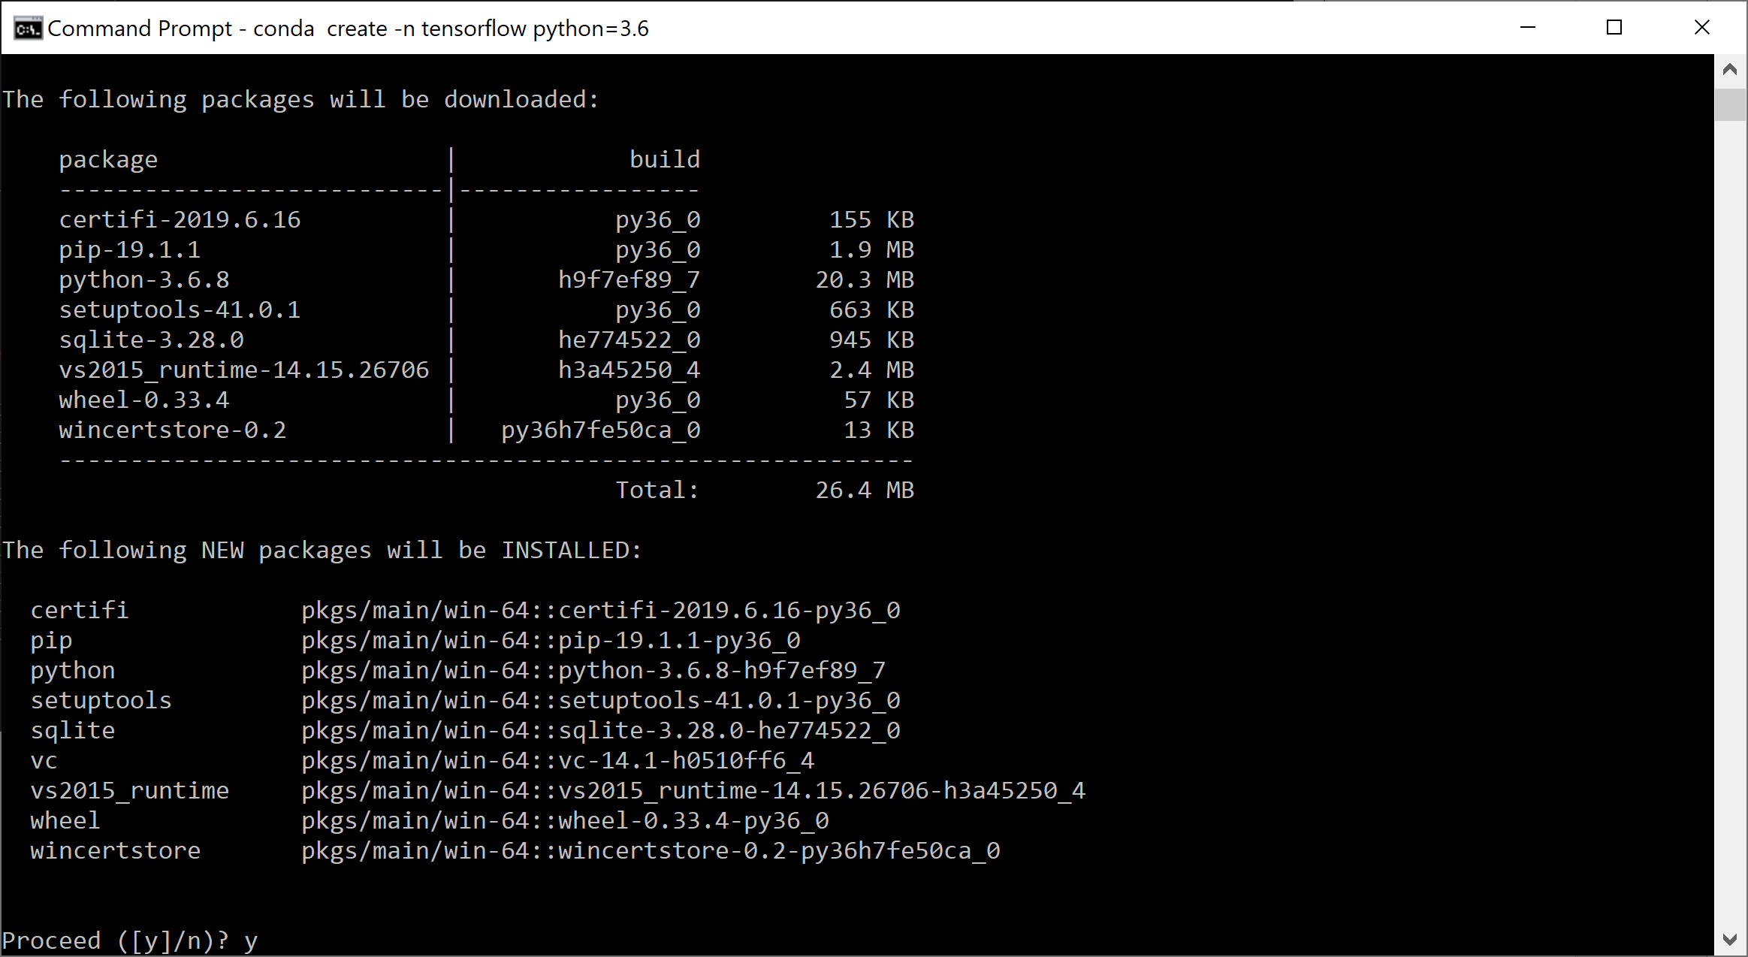
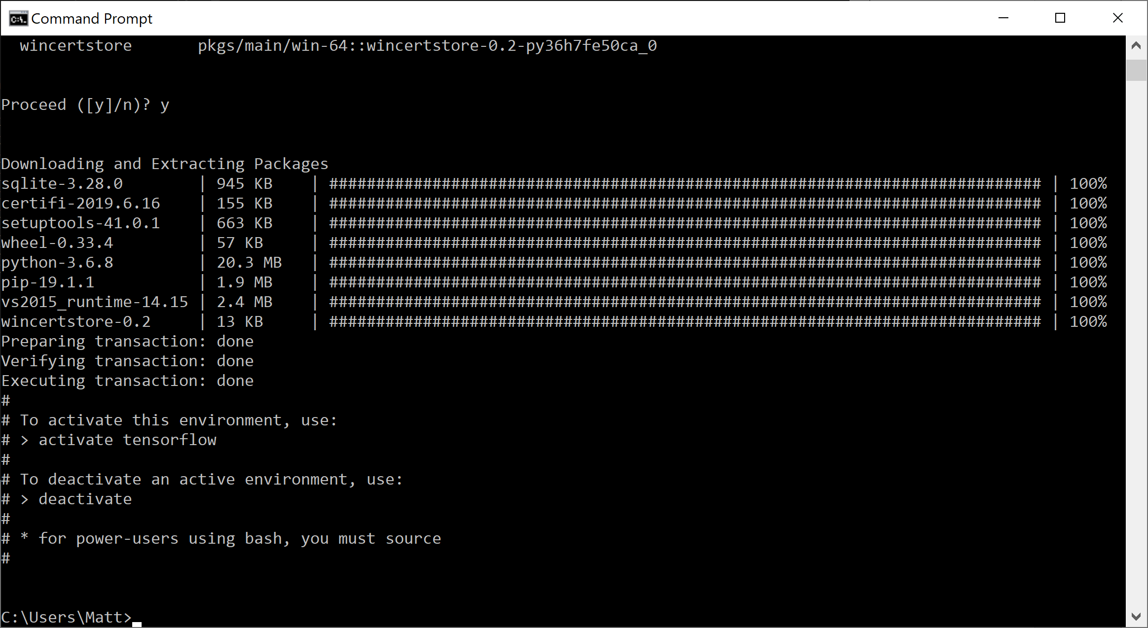
2b. Install TensorFlow (Command Prompt)
1
Enter: conda create –n tensorflow python=3.6
2
Enter: y
3
Enter “cmd“ and press enter.
(Open Command Prompt)
OK!

Slide 8
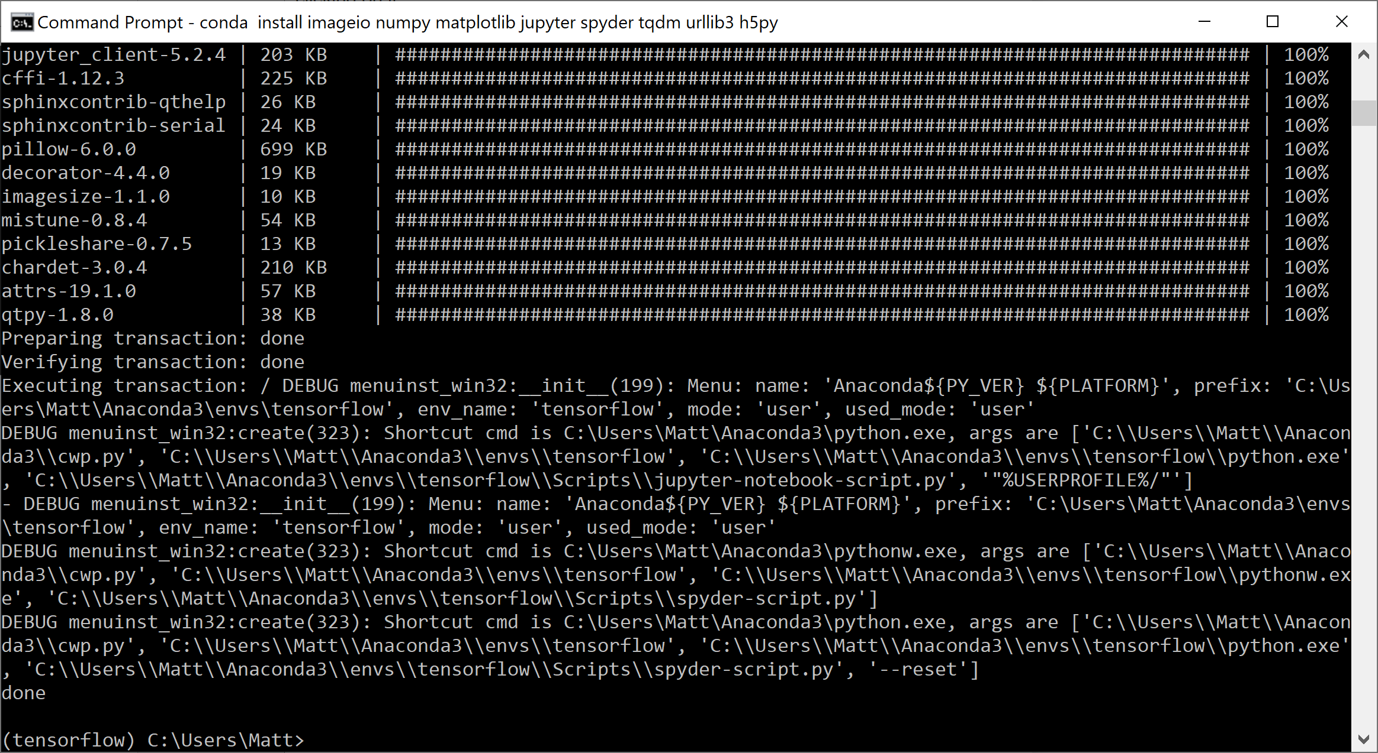
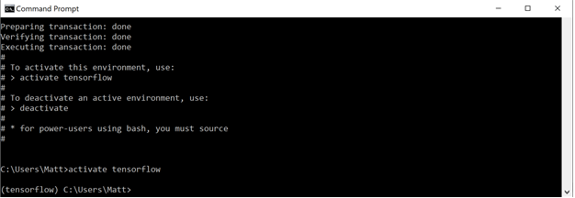
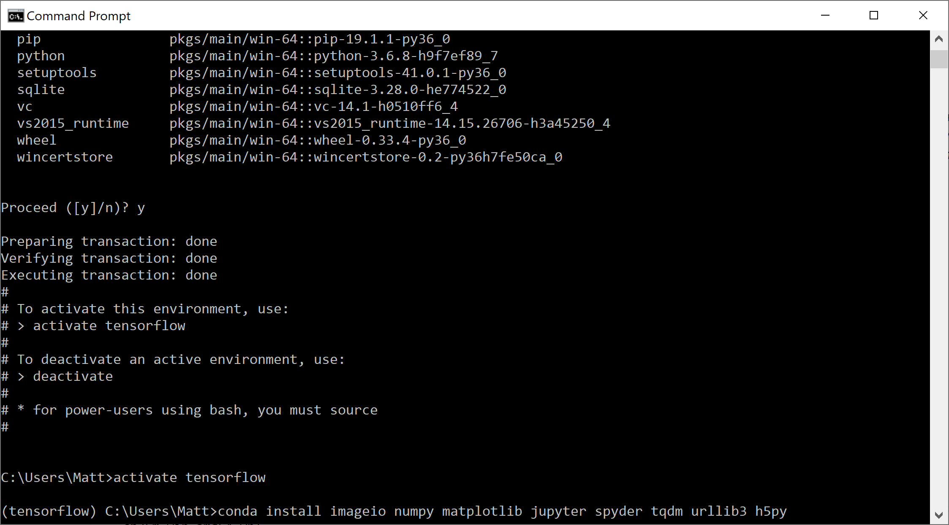
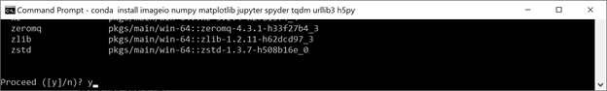
2b. Install TensorFlow (Activate)
1
Enter: activate tensorflow
4
2
Enter: conda install imageio numpy matplotlib jupyter spyder tqdm urllib3 h5py
OK!
Go thru all the steps
Enter: y
3

Slide 9
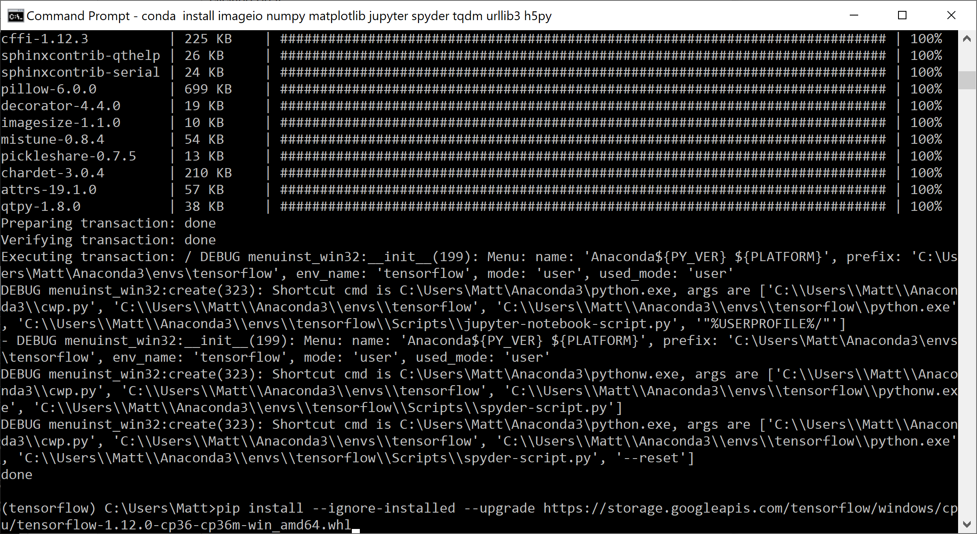
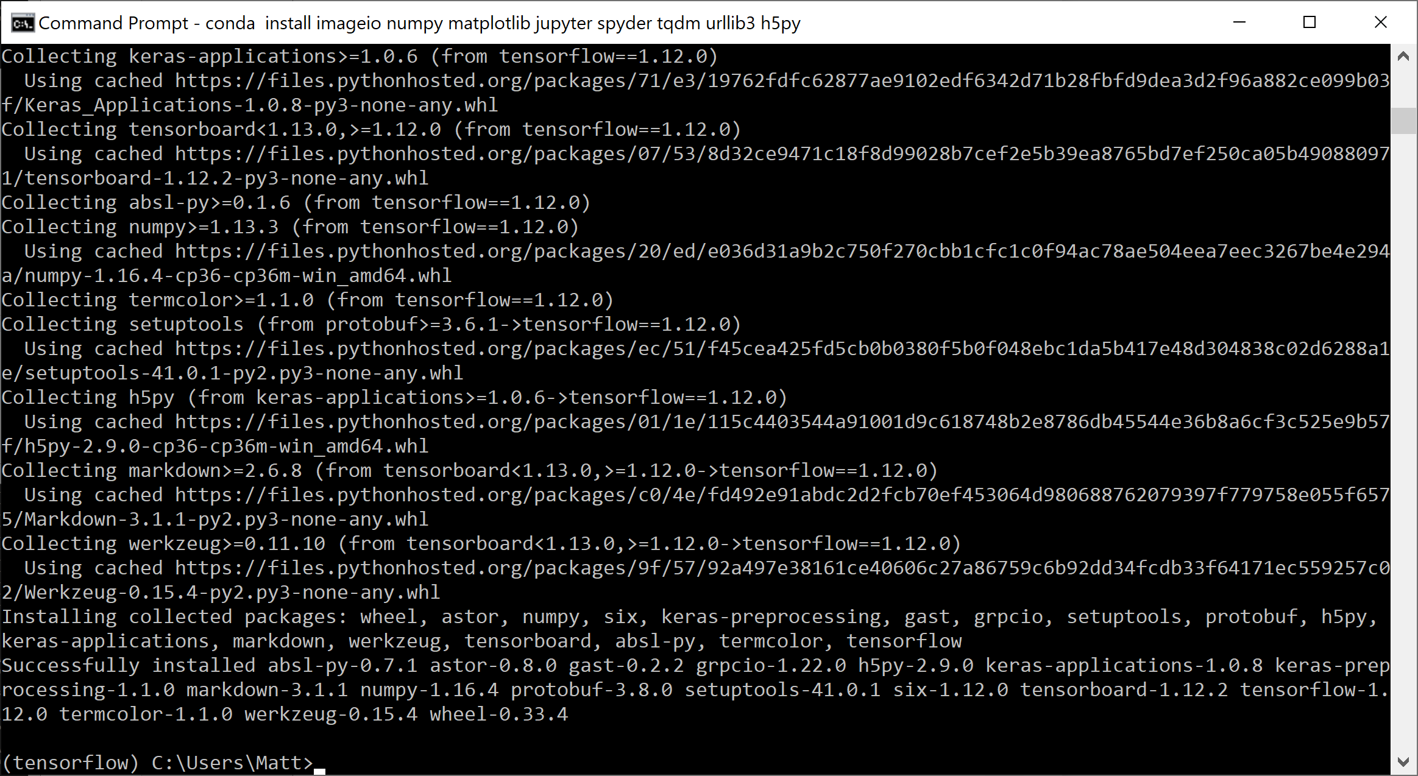
2b. Install TensorFlow (CPU)
1
Enter: pip install --ignore-installed --upgrade https://storage.googleapis.com/tensorflow/windows/cpu/tensorflow-1.12.0-cp36-cp36m-win_amd64.whl
2
Go thru all the steps
OK!
OK!

Slide 10
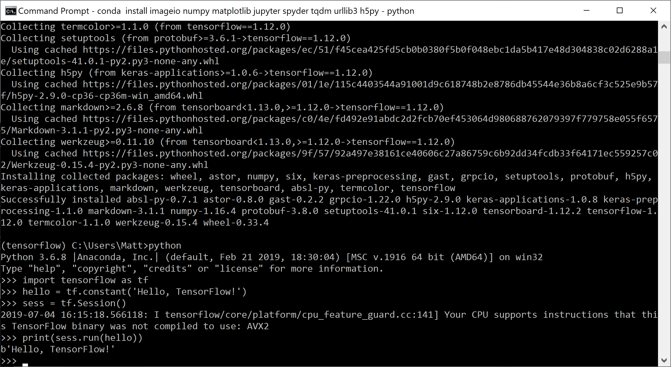
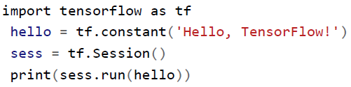
3. Verify TensorFlow Installation (Python Shell)
a)
b)
Enter: python
Enter this program into your Python shell:
Good job! : )

Slide 11
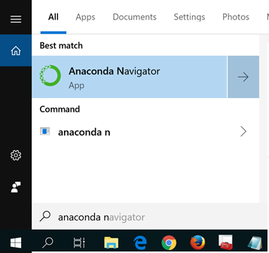
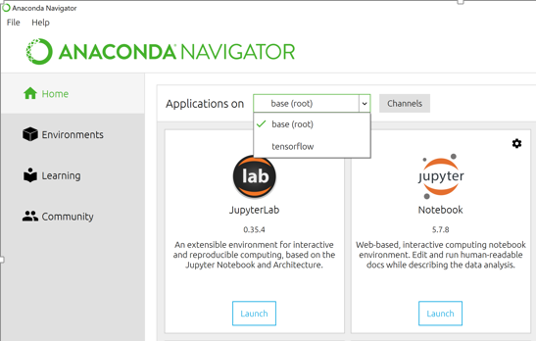
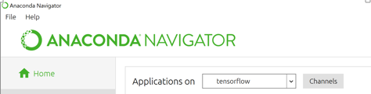
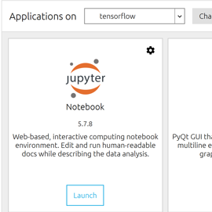
3. Verify TensorFlow Installation (JupyterNote book)
1
Click: tensorflow
Enter “anaconda navigator”
(Open the app)
2
Ensure: tensorflow is enable!
3
Click: Launch

Slide 12
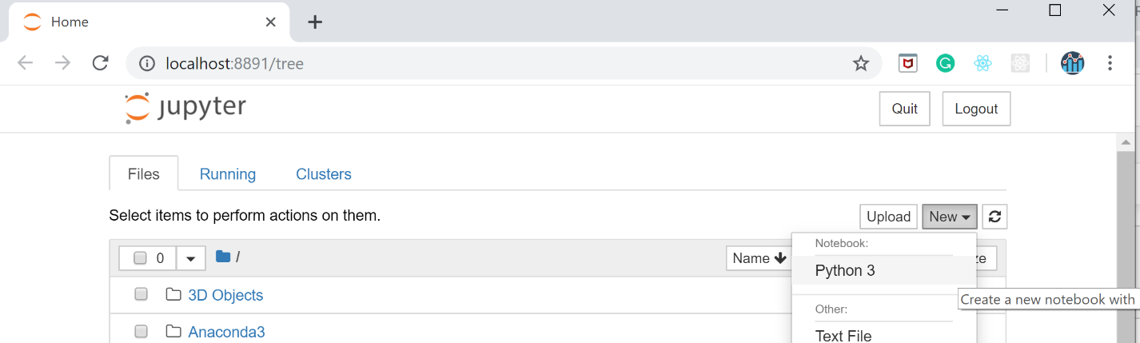
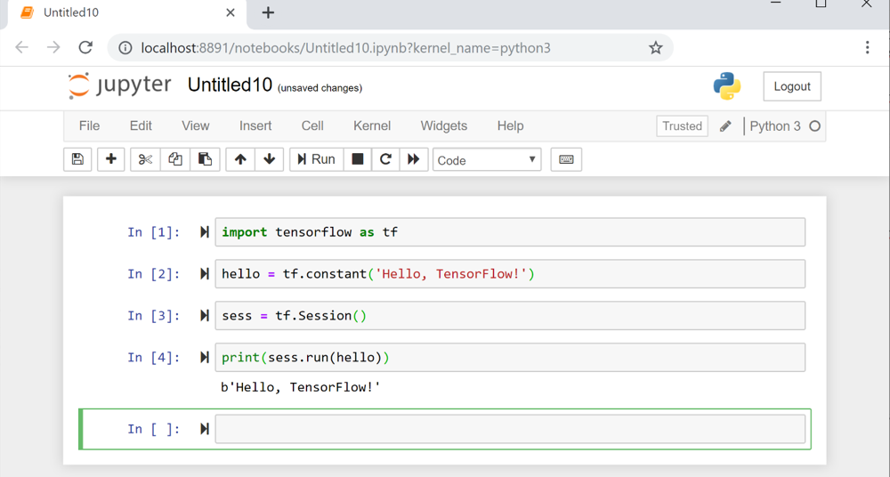
3. Verify TensorFlow Installation (JupyterNote book)
4
5
Good job! : )

Slide 13
Thank You

